Slide 1



WIREWIZARDS HACKATHON 2026
Problem Statement No - ECW260045
Problem Statement Title - Rain Detection and Outdoor Clothes Protection Alert
Team Name - CURRENT AFFAIRS
Faculty Mentor - Dr. Kamalakannan S
Team Members
Ragupathi V
Navin Kumar S
Vignesh R
Yashvanth B

Slide 2
RAINGUARD: SMART CLOTHES PROTECTION
Proposed Solution
What we built: A small setup that notices rain the moment it starts and swings the clothes line under cover, so nobody has to run outside when the sky suddenly turns dark.
Why it helps: We have all come home to clothes that were dry in the morning and soaked by evening. RainGuard watches the weather for you, even when no one is at home.
What makes it different: It is cheap, easy to build with common parts, and needs no internet. It simply senses, decides and moves on its own.

Slide 3
TECHNICAL APPROACH
What we are using
How it works
Arduino Uno: the brain of the project
Rain sensor module: feels water drops on its plate
Servo motor: moves the clothes line under shelter
Breadboard and jumper wires: for quick, easy connections
Arduino IDE (C/C++): to write and upload the code
Rain falls on the sensor plate
▼
Arduino reads the signal
▼
Servo moves the clothes under shelter
▼
Rain stops and the plate dries
▼
Clothes are moved back out

Slide 4
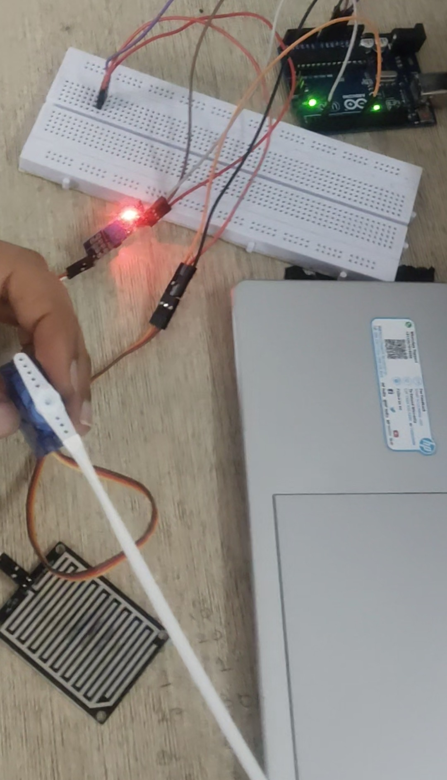
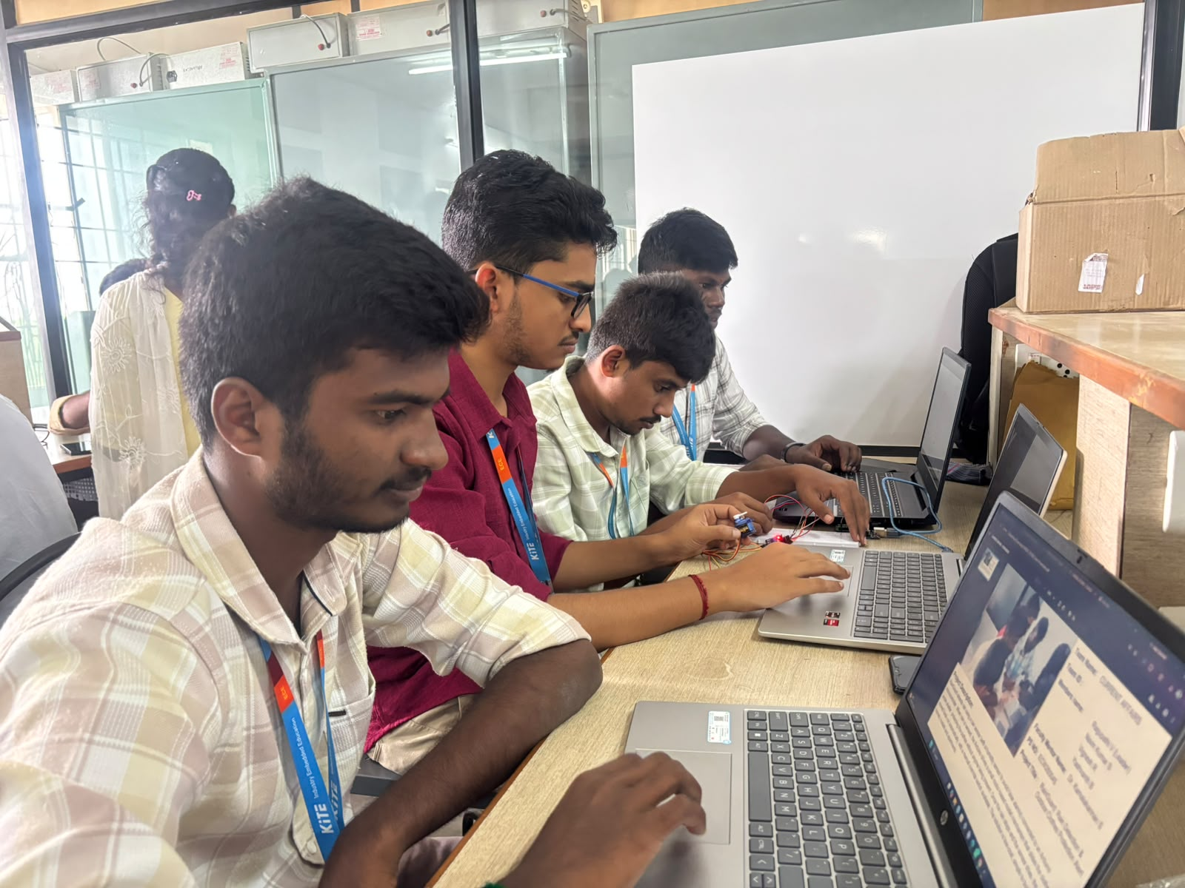
PROTOTYPE & PROJECT DEMONSTRATION
Prototype / Working Model: Arduino, rain sensor and servo motor
Our team presenting the project

